Slide 1
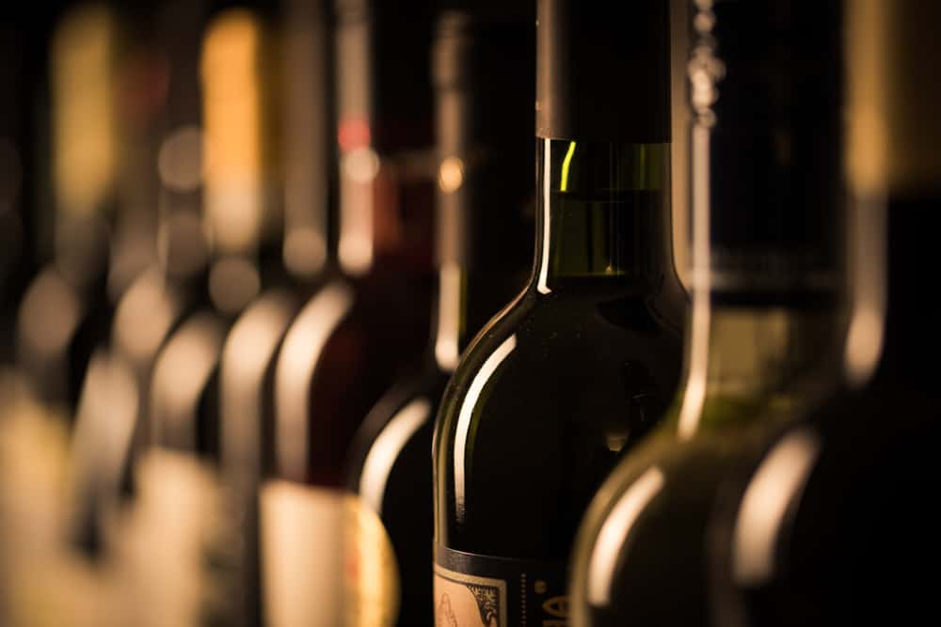
Wine Quality Prediction Using Machine Learning

Slide 2
Introduction
About Wine:
Wine is a beverage made from fermented grape and other fruit juices with lower amount of alcohol content.
Quality of wine is graded based on the taste of wine & vintage. This process is time taking, costly & not efficient
A wine itself includes different parameters like fixed acidity, volatile acidity, citric acid, residual sugar, chlorides, free Sulphur dioxide, total Sulphur dioxide, density, pH, Sulphates, alcohol and quality.
Problem Statement:
In industries, understanding the demands of wine safety testing can be a complex task for the laboratory with numerous analytes and residues to monitor.
But our application’s prediction, provide ideal solutions for the analysis of wine, which will make this whole process efficient and cheaper with less human interaction.

Slide 3
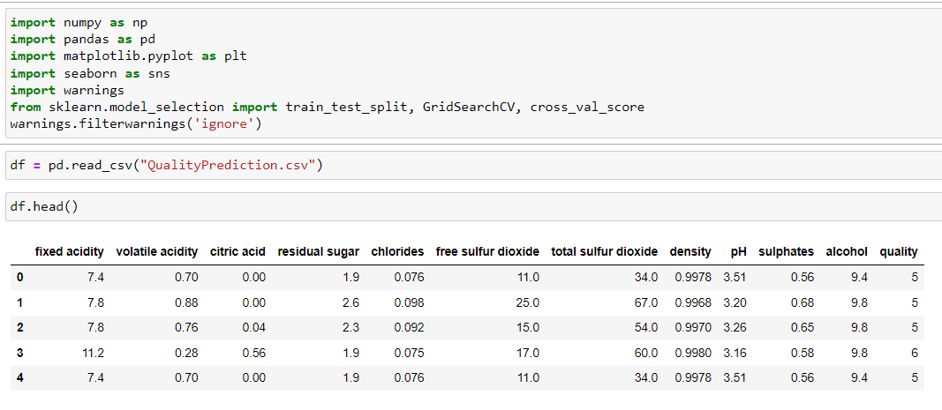
Importing the all the required libraries and visualizing the Data set.
Description of Dataset:
If you download the dataset, you can see that several features will be used to classify the quality of wine, many of them are chemical, so we need to have a basic understanding of such chemicals.
Volatile acidity : Volatile acidity is the gaseous acids present in wine.
Fixed acidity : Primary fixed acids found in wine are tartaric, succinic, citric, and malic
Residual sugar : Amount of sugar left after fermentation.
Citric acid : It is weak organic acid, found in citrus fruits naturally.
Chlorides : Amount of salt present in wine.
free sulfur dioxide : So2 is used for prevention of wine by oxidation and microbial spoilage.
Total sulfur dioxide
pH : In wine pH is used for checking acidity
density
Sulphates : Added sulfites preserve freshness and protect wine from oxidation, and bacteria.
Alcohol : Percent of alcohol present in wine.

Slide 4
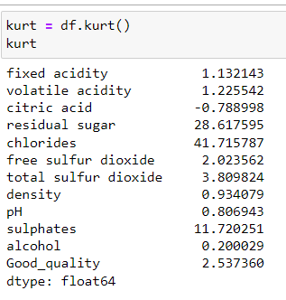
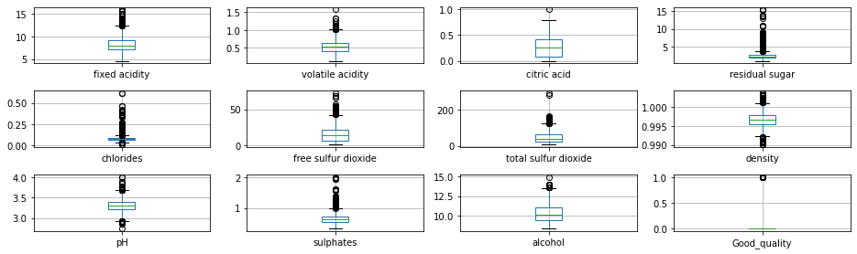
This is the visualization of the box plots to check the presence of the outliers in each feature. Most of the features consist of outliers.
We can see that “chlorides”, “residual sugar”, and “sulfate” are having more outliers

Slide 5
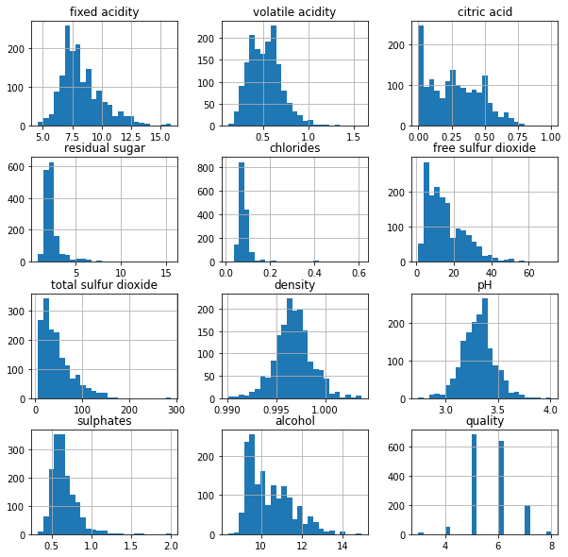
Looking that this histogram plot, it looks like most of the features are not normally distributed. One of the reasons is, this dataset contains a lot of outliers.

Slide 6
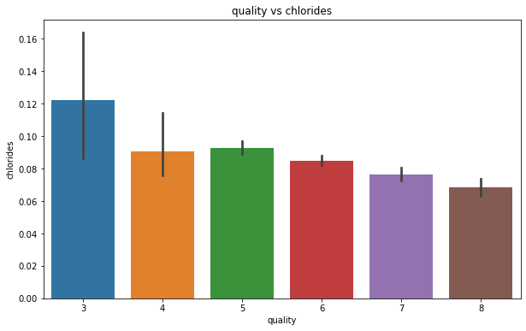
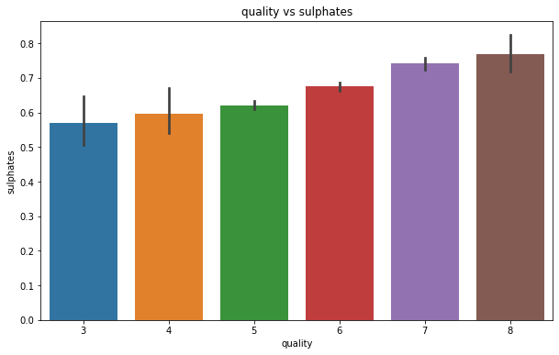
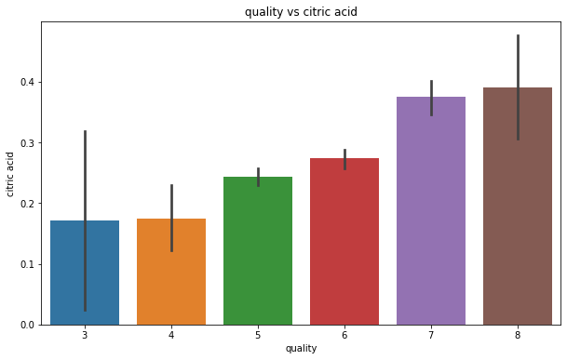
By looking at above bar plots, we can draw below conclusions..
As the Chloride content is increasing, the Quality of the wine is getting decreased
As the Sulphate content is increasing, the Quality of the wine is getting Increased
As the Citric acid content is increasing, the Quality of the wine is getting Increased

Slide 7
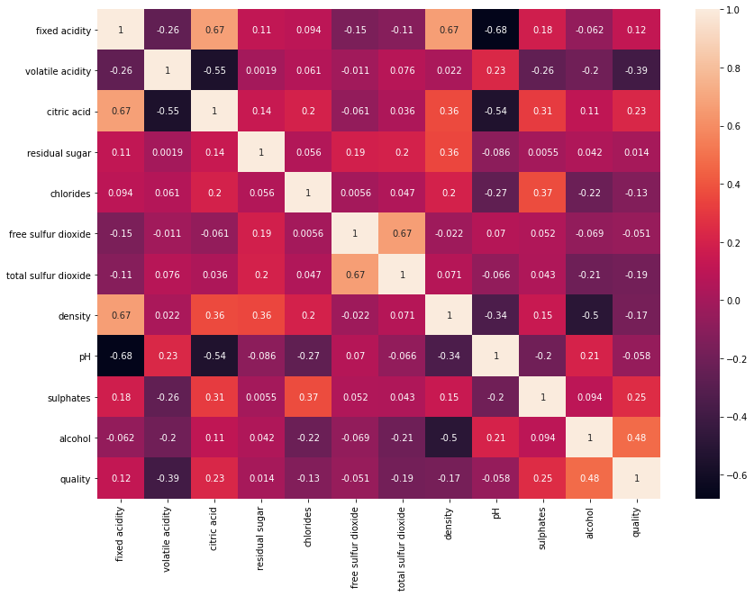
From heatmap we can see that there is a good correlation between alcohol, citric acid and sulphates(independent variable) and quality(target variable)
We can also observe that there is a relative positive correlation between fixed_acidity and citric_acid, fixed_acidity and density and between free sulfur dioxide and total sulfur dioxide.
Similarly we can observe there is a relatively high negative correlation between fixed_acidity and pH.

Slide 8
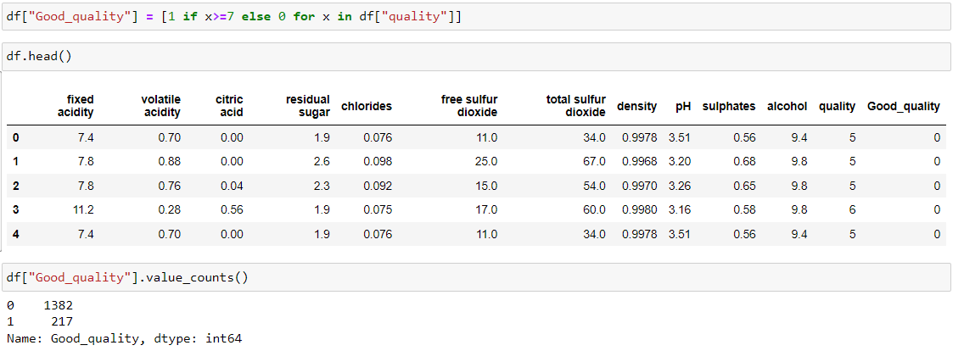
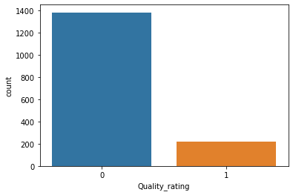
We have defined the classes by considering all the ratings which are greater than or equal to 7 as class-1 and rest of them as class-0 .
After redefining the quality rating, we can see that there are 1382 rows which belongs to class-0 and 217 rows which belongs to the class-1

Slide 9
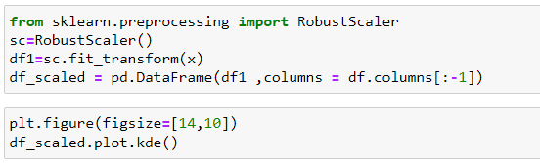
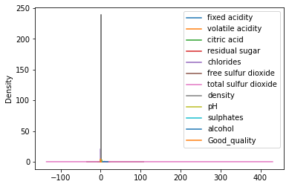
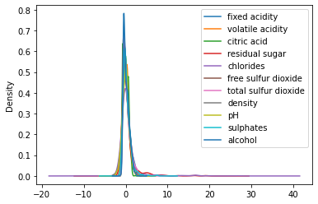
Preprocessing
We perform the normalization to convert all the features into the same scale. RobustScaler is one such technique where we scale all the features in the scale between -1 to +1
In the fist plot, we can see that the features are in different scale.
Once running the RobustScaling normalization technique on the dataset, we can see that the features are converted into same scale.
Before Normalization
After Normalization

Slide 10
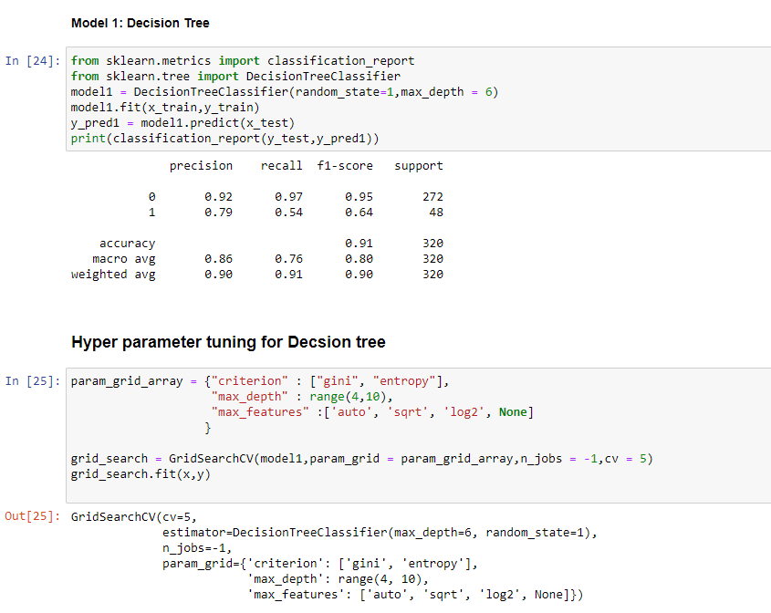
Decision Tree Model Building & Hyperparameter Tuning
We are using Decision Tree classifier here. The standard procedure of initializing and fitting the model is shown in the slide.
Decision tree is the most powerful and popular tool for classification and prediction. A Decision tree is a flowchart like tree structure, where each internal node denotes a test on an attribute, each branch represents an outcome of the test, and each leaf node (terminal node) holds a class label.
GridSearchCV is a library function that is a member of sklearn's model_selection package. It helps to loop through predefined hyperparameters and fit your estimator (model) on your training set. So, in the end, you can select the best parameters from the listed hyperparameters

Slide 11
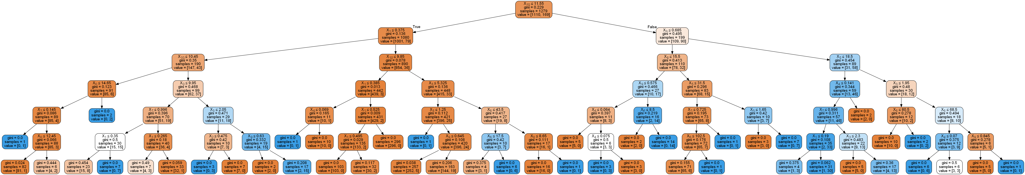
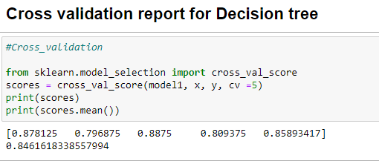
Visualization of Decision Tree

Slide 12
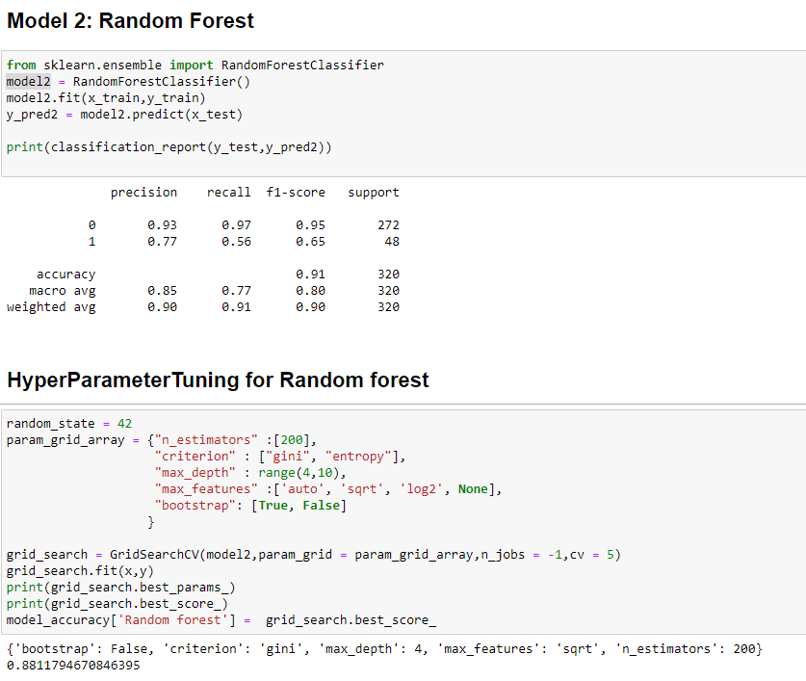
Random forest Model Building &
Hyperparameter Tuning
Random forests or random decision forests are an ensemble learning method for classification, regression and other tasks that operates by constructing a multitude of decision trees at training time. For classification tasks, the output of the random forest is the class selected by most trees.
The best params are :
{'bootstrap': False, 'criterion': 'gini', 'max_depth': 4, 'max_features': 'sqrt', 'n_estimators': 200}

Slide 13
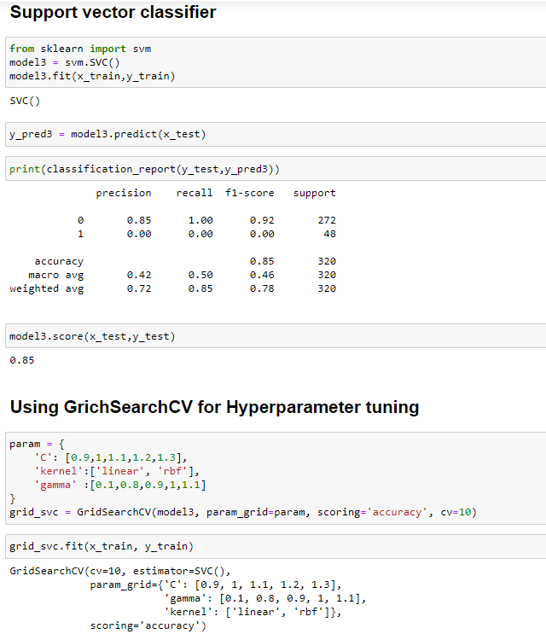
Support Vector Classifier & Hyperparameter Tuning
Support vectors are data points that are closer to the hyperplane and influence the position and orientation of the hyperplane. Using these support vectors, we maximize the margin of the classifier. Deleting the support vectors will change the position of the hyperplane. These are the points that help us build our SVM.
The best params are :
{'C': 1, 'gamma': 0.8, 'kernel': 'rbf'}

Slide 14
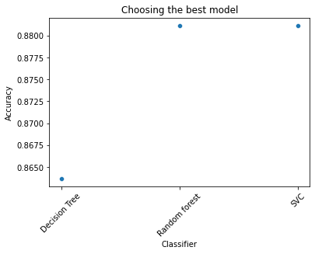
Who is the Best Performer ?
Out of all 3 classifiers, Random forest performed well and gave us the best accuracy which is 88%.

